Slide 1
3mmm
Blake
isiaha

Slide 2

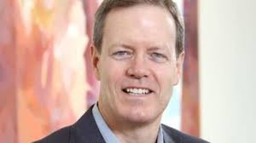
The chief executive officer
Michael Roman Appointed 3M Chief Executive Officer
"Our playbook is working," Roman said. "It's delivering value for our customers, it's delivering premium returns for our investors. My role as CEO is to build on that."

Slide 3
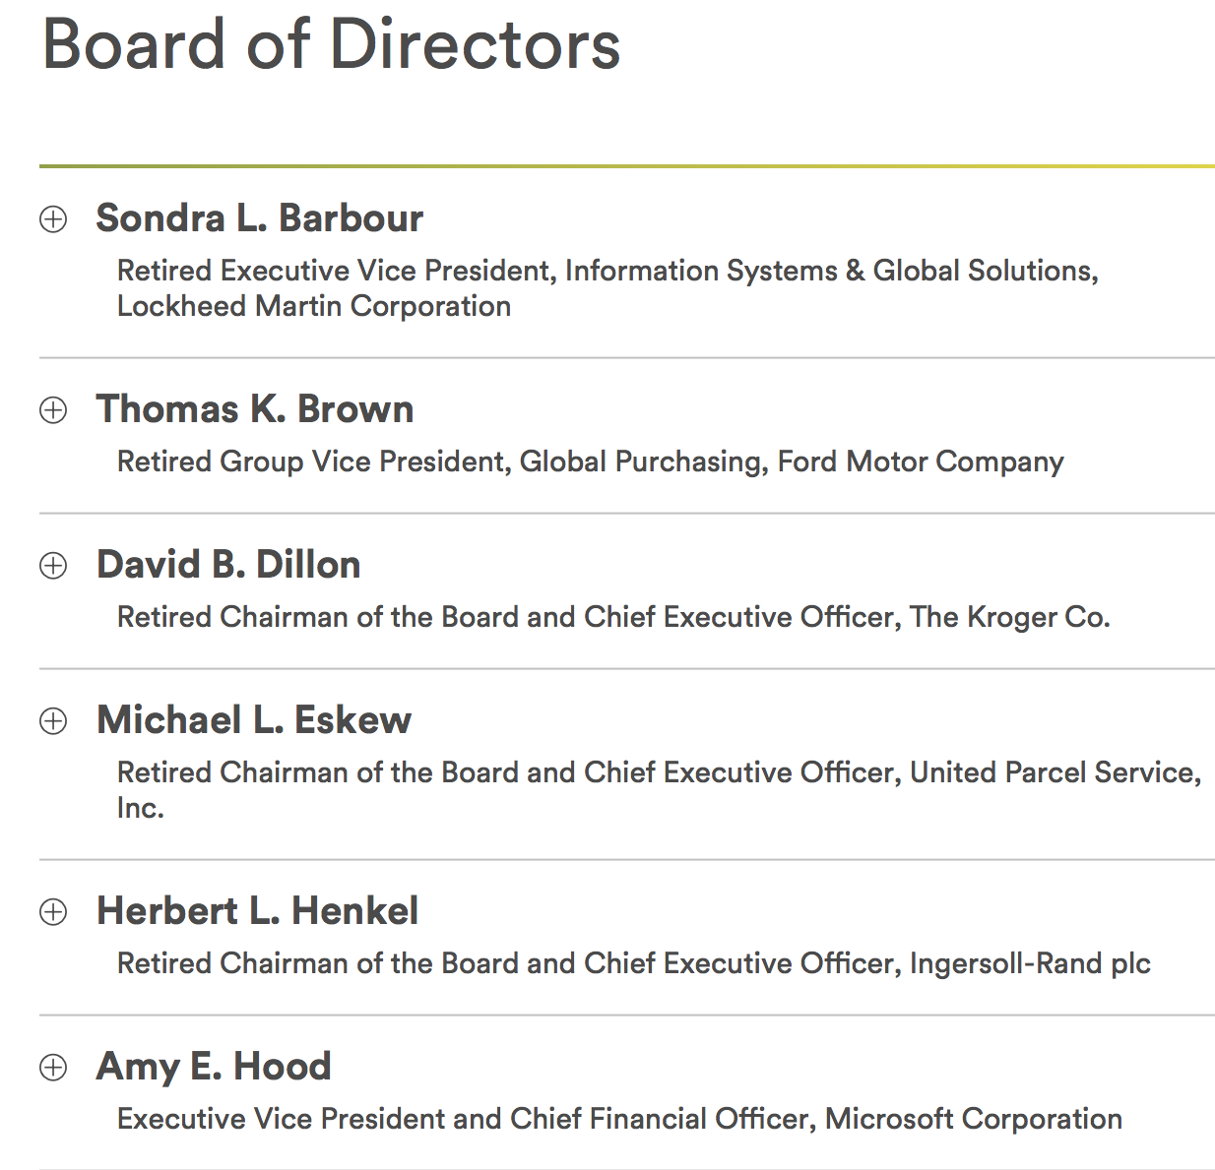
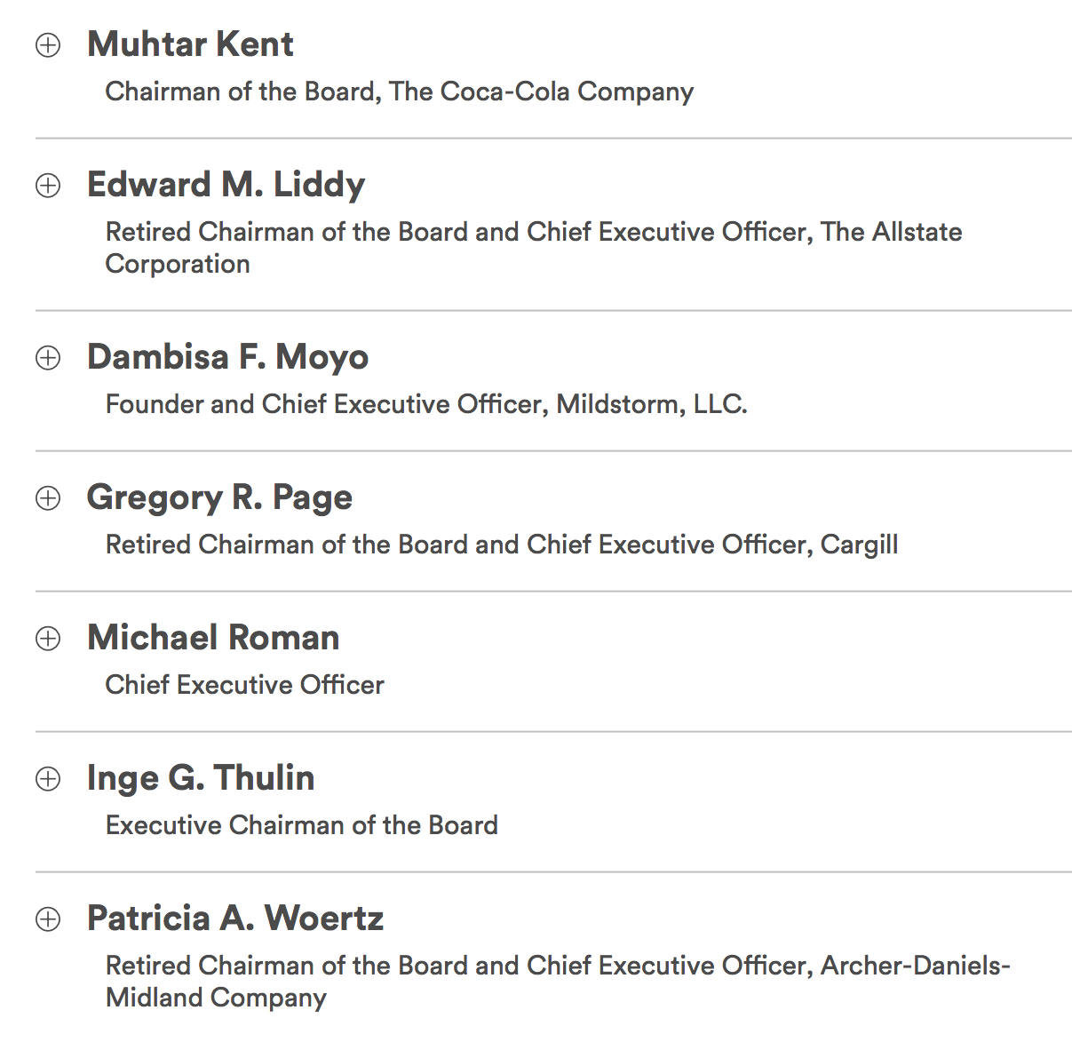
3mmm board of directors

Slide 4
Financial market concerns
Firm | Analyst | Phone
Argus Research | John Eade | +1 646 747 5445
Bank of America Merrill Lynch | Andrew Obin | +1 646 855 1817
Barclays | Julian Mitchell | +1 212 526 1661
Citi Research | Andrew Kaplowitz | +1 212 816 0642
Credit Suisse | John Walsh | +1 212 538 1664
Deutsche Bank | Nicole DeBlase | +1 212 250 5916
Goldman Sachs | Joe Ritchie | +1 212 357 8914
Jefferies & Company | Laurence Alexander | +1 212 284 2553
J.P. Morgan Securities | Stephen Tusa | +1 212 622 6623
Langenberg & Company | Brian Langenberg | +1 312 235 6521
Melius Research | Scott Davis | +1 212-503-6200
Morgan Stanley | Josh Pokrzywinski | +1 212 761 4000
Morningstar | Joshua Aguilar | +1 312 696 6381
RBC Capital Markets | Deane Dray | +1 212 428 6465
Stifel Nicolaus & Company | Rob McCarthy | +1 212 271 3575
UBS | Steven Winoker | +1 212 713 2716
Vertical Research Partners | Jeff Sprague | +1 203 276 5665
William Blair & Company | Nick Heymann | +1 212 237 2740
Wolfe Research | Nigel Coe | +1 646 582 9259
Analyst Coverage
3M Company is followed by the analysts listed above. Please note that any opinions, estimates or forecasts regarding 3M Company's performance made by these analysts are theirs alone and do not represent opinions, forecasts or predictions of 3M Company or its management. 3M Company does not by its reference above or distribution imply its endorsement of or concurrence with such information, conclusions or recommendations.

Slide 5
Financial market concerns
3 MMM
Share Volume
1,565,508
90 Day Avg. Daily Volume
2,472,136
PPG
Share Volume
2,601,857
90 Day Avg. Daily Volume
1,801,685

